Slide 1
Machine Learning: Set up in Azure

Slide 2
Microsoft Azure Portal
https://azure.microsoft.com

Slide 3
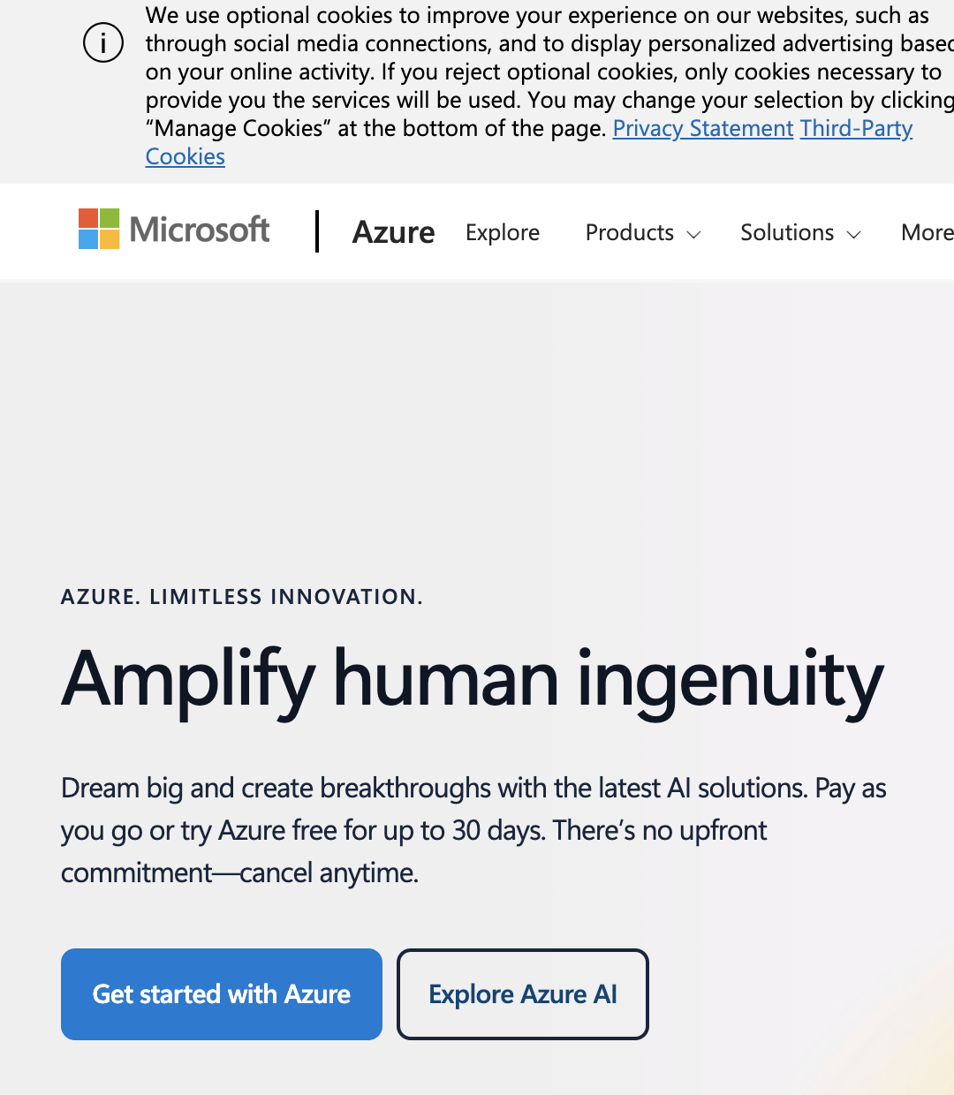
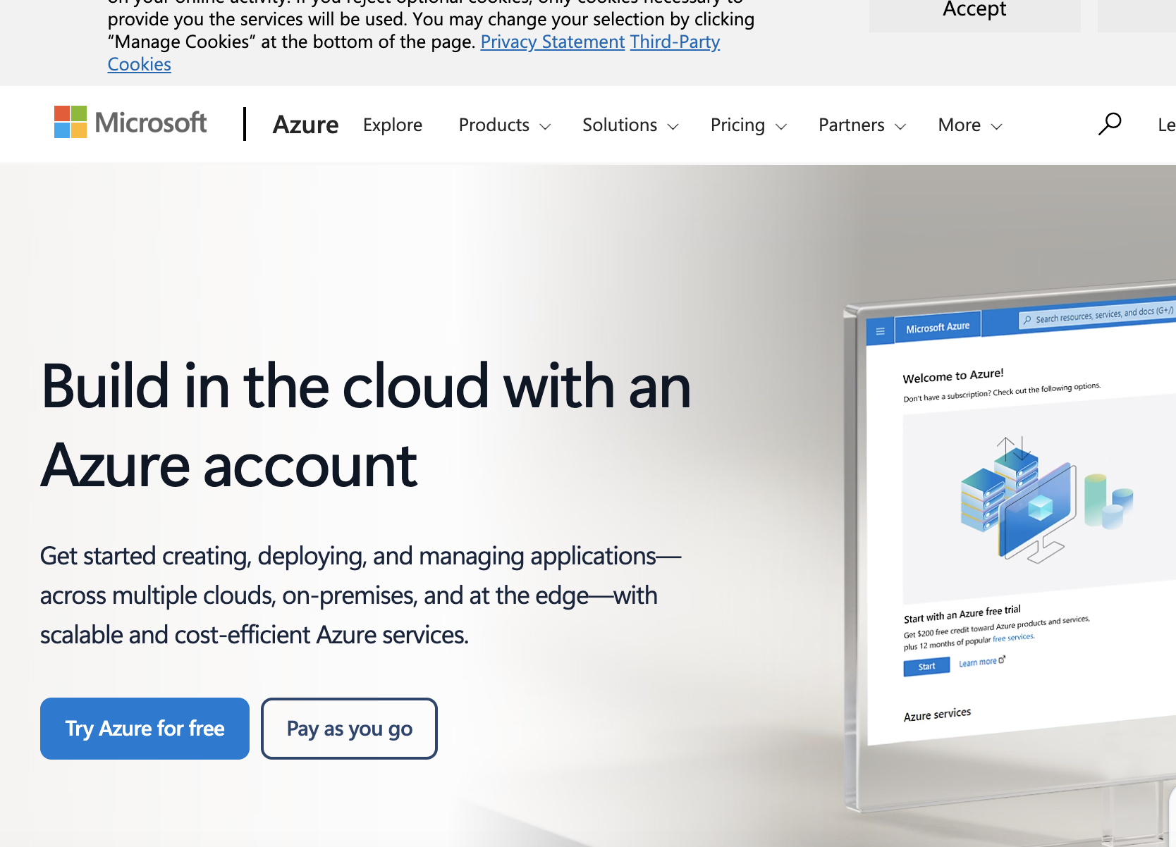
1.Sign in to Azure portal . Click on Get Started with Azure and then try Azure for free

Slide 4
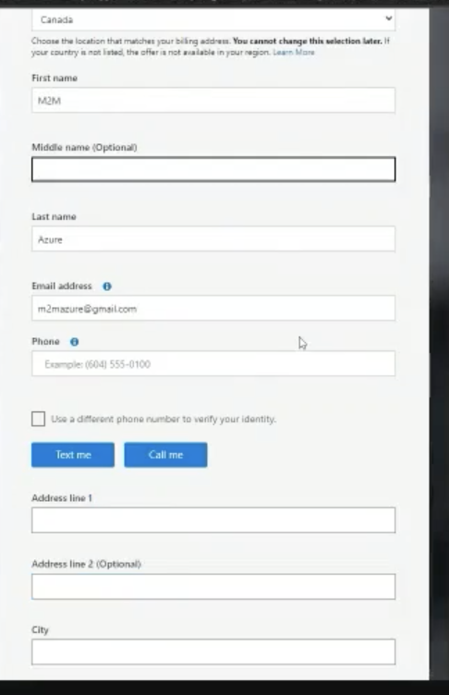
1.Create a profile

Slide 5
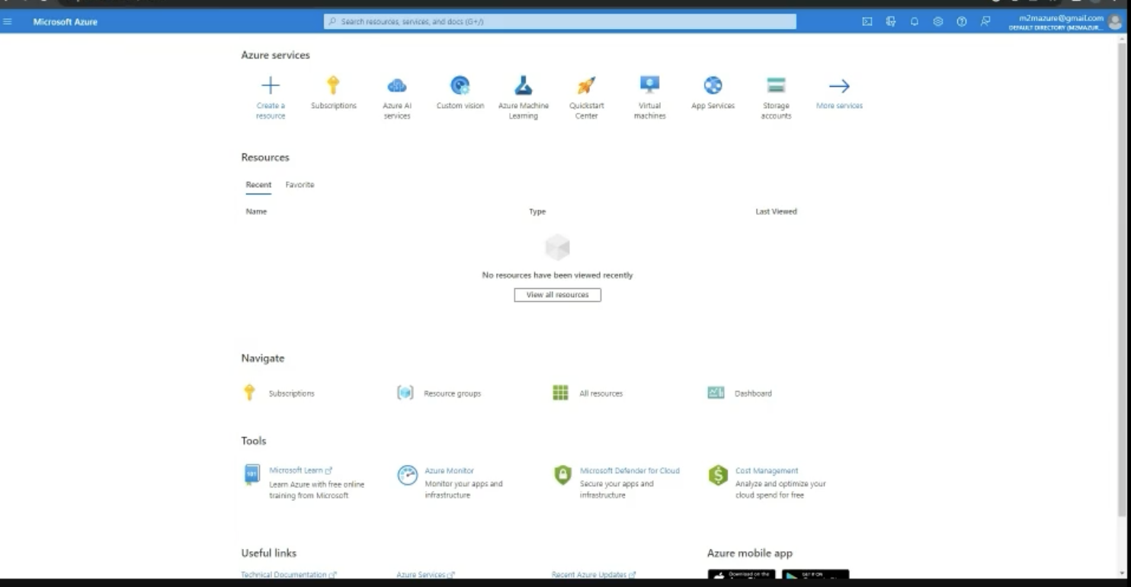
After creating the profile, you can go to the home page and click on subscriptions

Slide 6
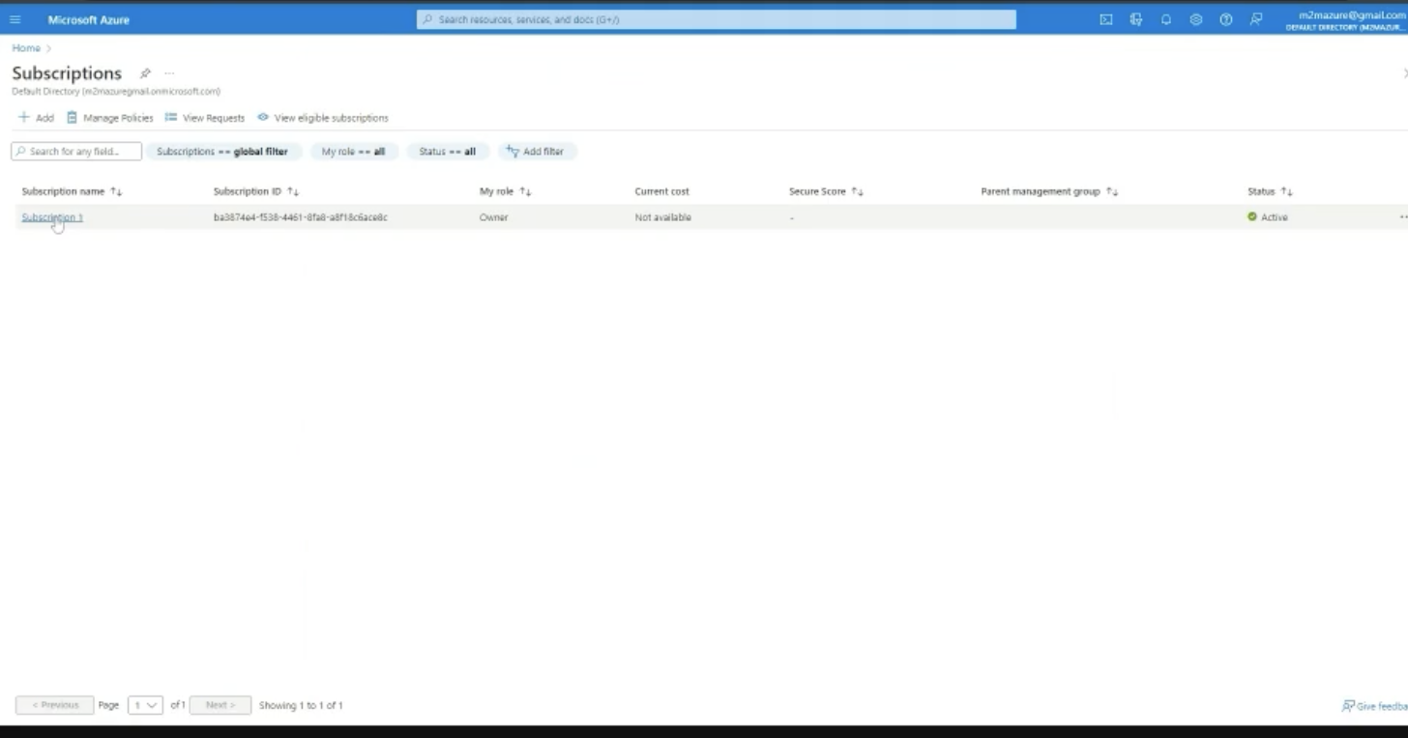
Click on the Subscriptions to view more details about our subscription.

Slide 7
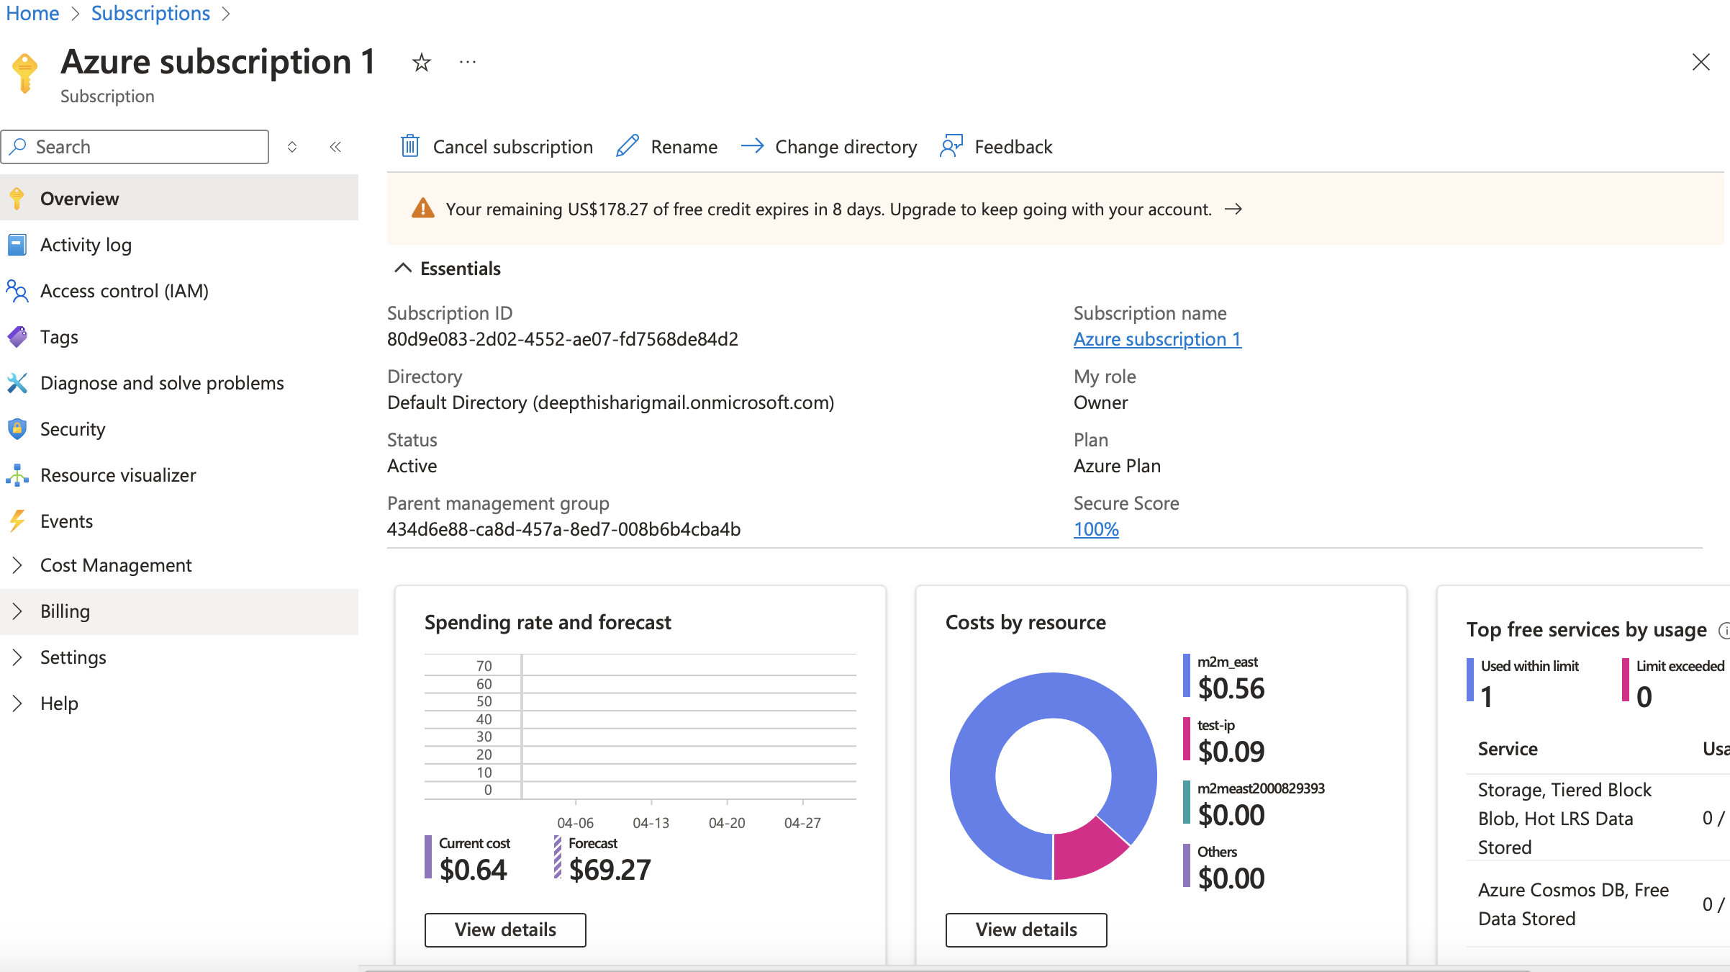
Subscription Window provides an overview of our subscription

Slide 8
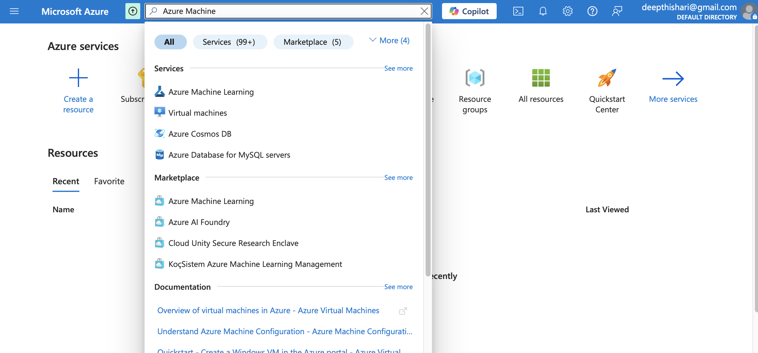
Create ML WorkSpace .
Go to home page and search for Azure Machine Learning and select .

Slide 9
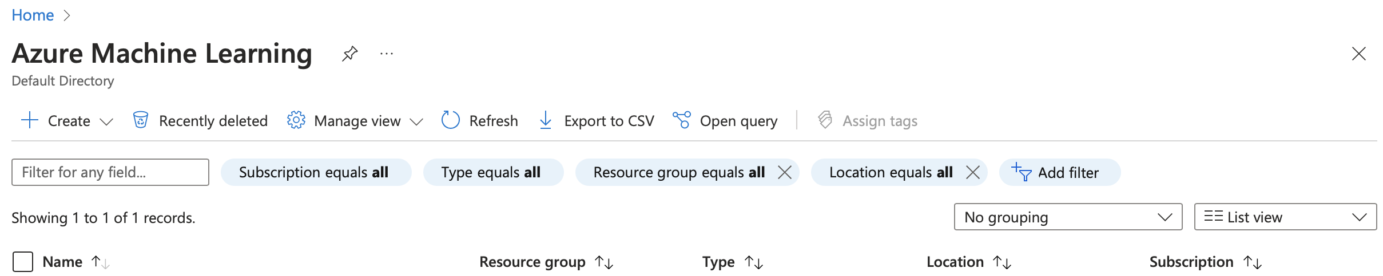

Create ML WorkSpace .
Click On the Create.

Slide 10
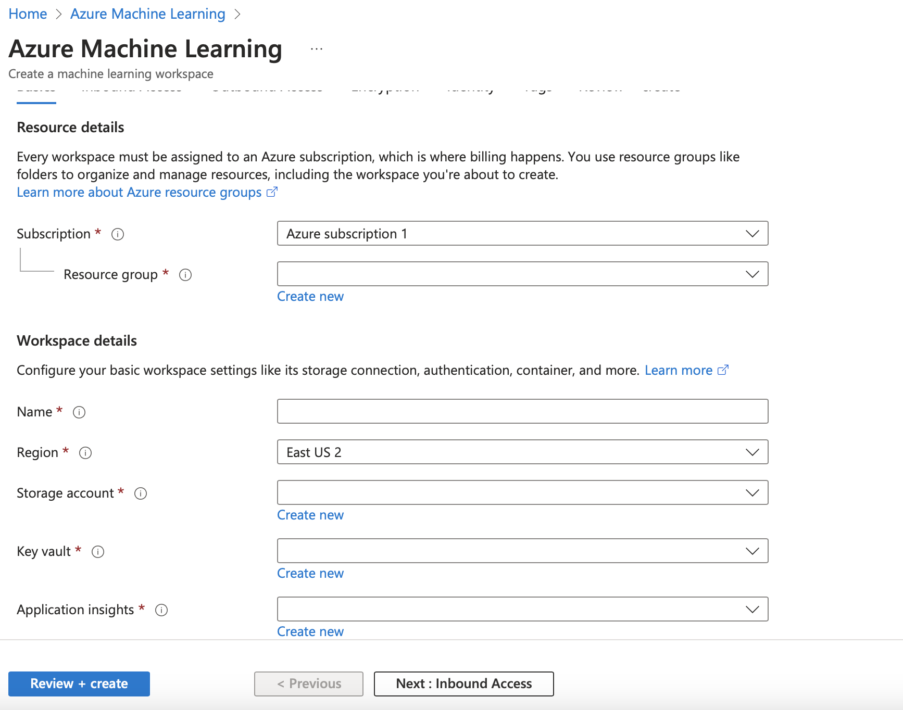
Create ML WorkSpace .
Fill the basic information in the next window.

Slide 11
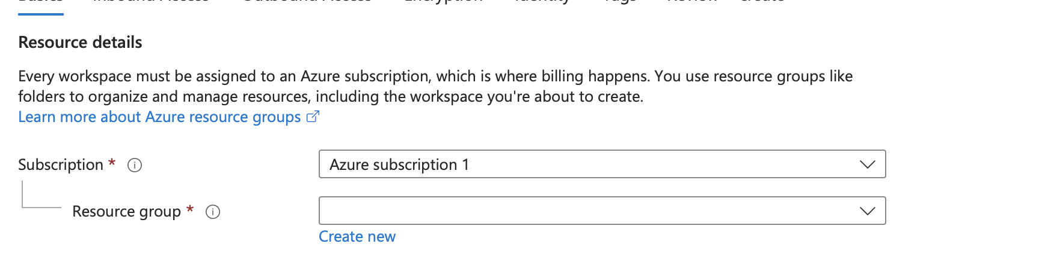
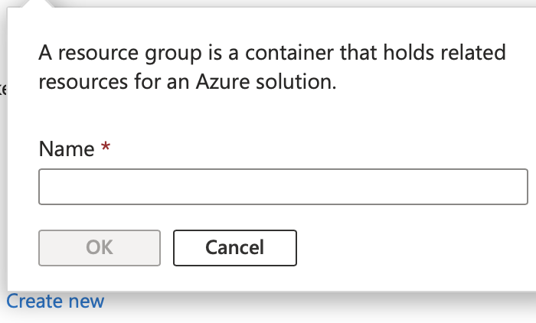
Create ML Work Space .
Let s fill the resource details first.
Select our subscription from the drop down
We don’t have existing resource group. click on ‘Create new’
Provide a name for resource group and click
OK’

Slide 12
Create ML Work Space .
Let s fill the resource details first.
Select our subscription from the drop down
We don’t have existing resource group. click on ‘Create new’
Provide a name for resource group and click
OK’

Slide 13
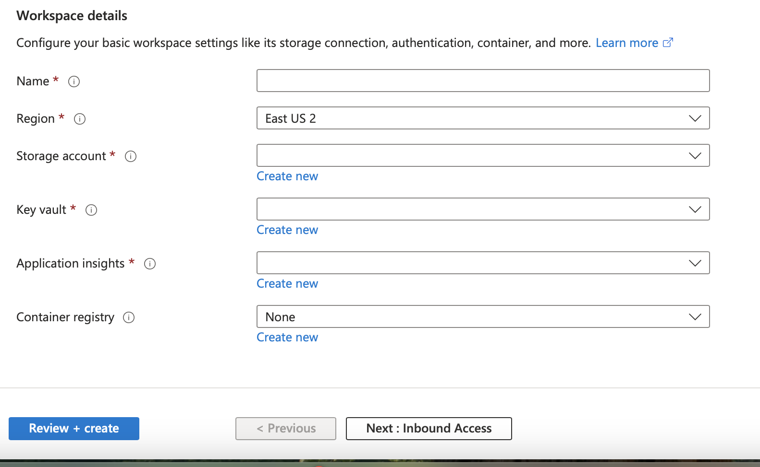
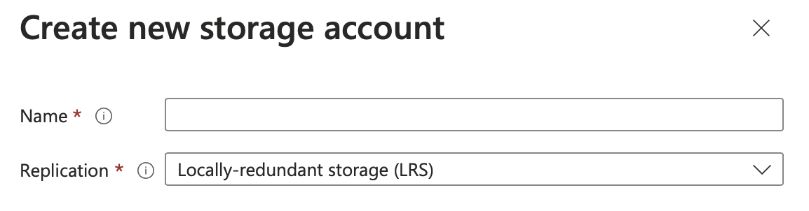
Create ML Workspace .
Next, fill the workspace details
Give a Unique name for the workspace
Select Region near to your demographic location
To create new storage account,click on ‘Create New’ and give a name
Create New key vault and Application Insights
Finally,Click on Review + Create

Slide 14
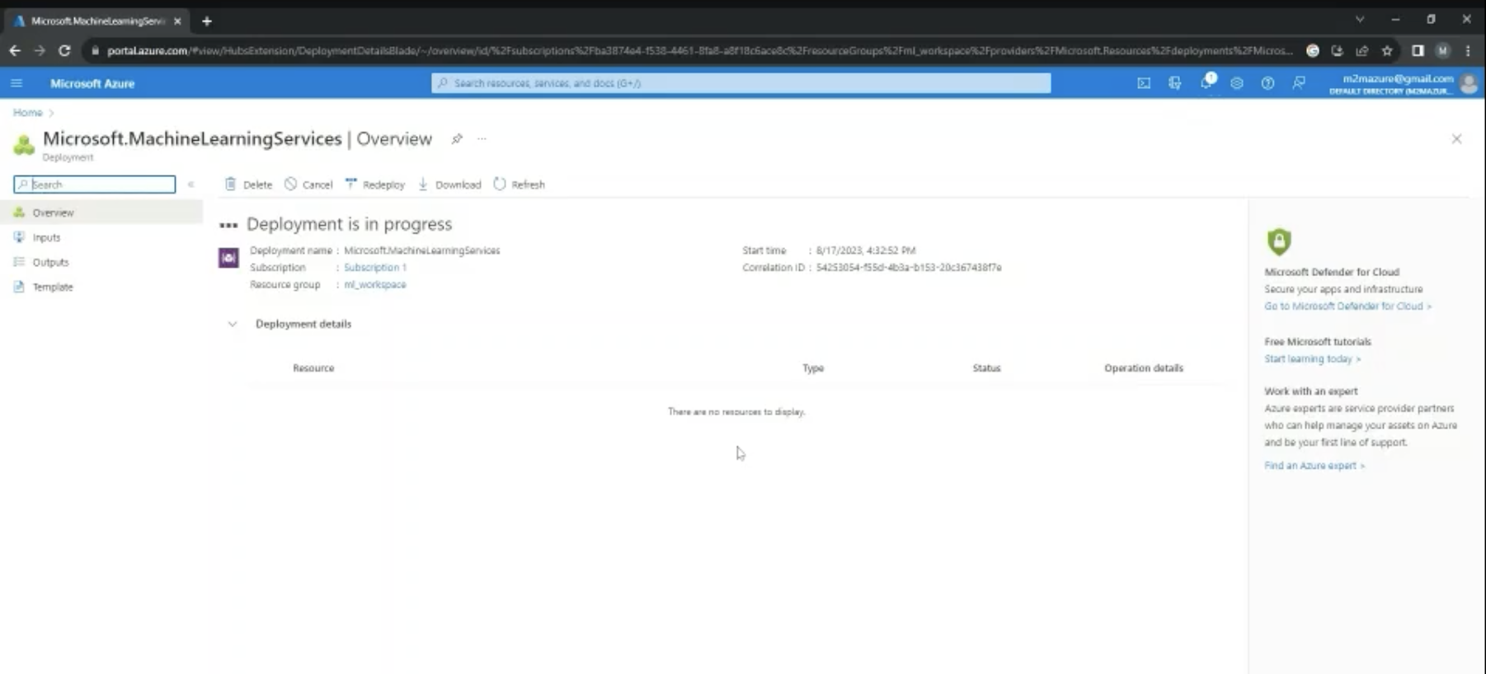
Create ML Workspace
Deployment will take a few minutes

Slide 15
Create ML Workspace

Slide 16
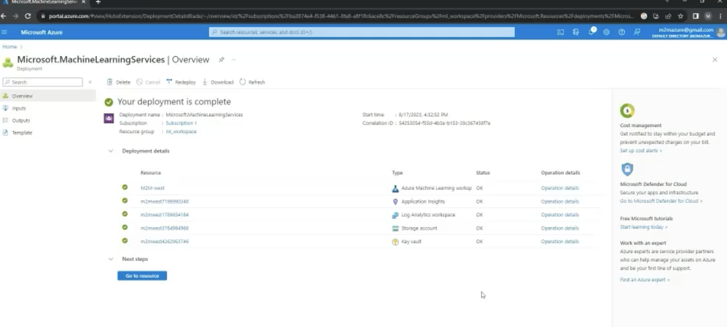

Create ML Workspace

Slide 17
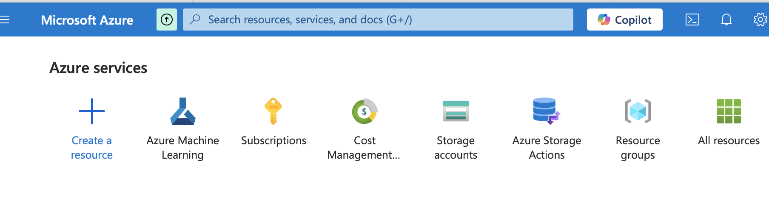
Create ML Workspace
Click on home and Navigate to home page.
Either click on Azure Machine Learning Workspace or search it in the search bar

Slide 18
Create ML Workspace
Click on home and Navigate to home page.
Either click on Azure Machine Learning Workspace or search it in the search bar

Slide 19
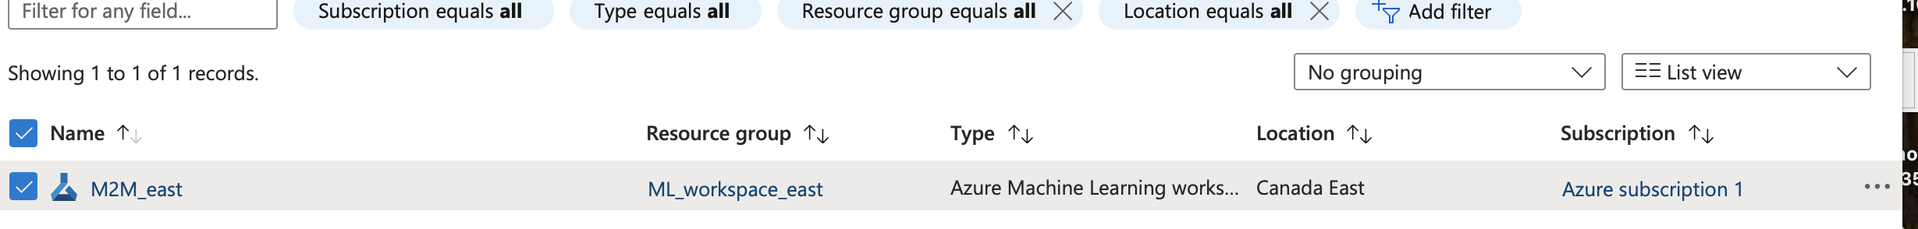
Create ML Workspace
Workspace is created. Click on the workspace name to view the details

Slide 20
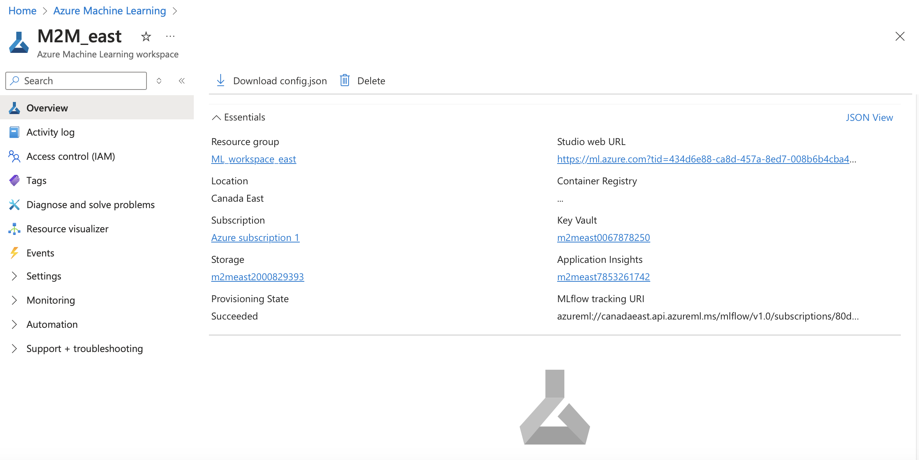
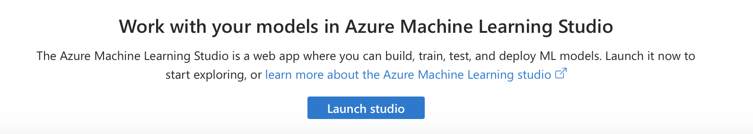
Click on launch studio

Slide 21
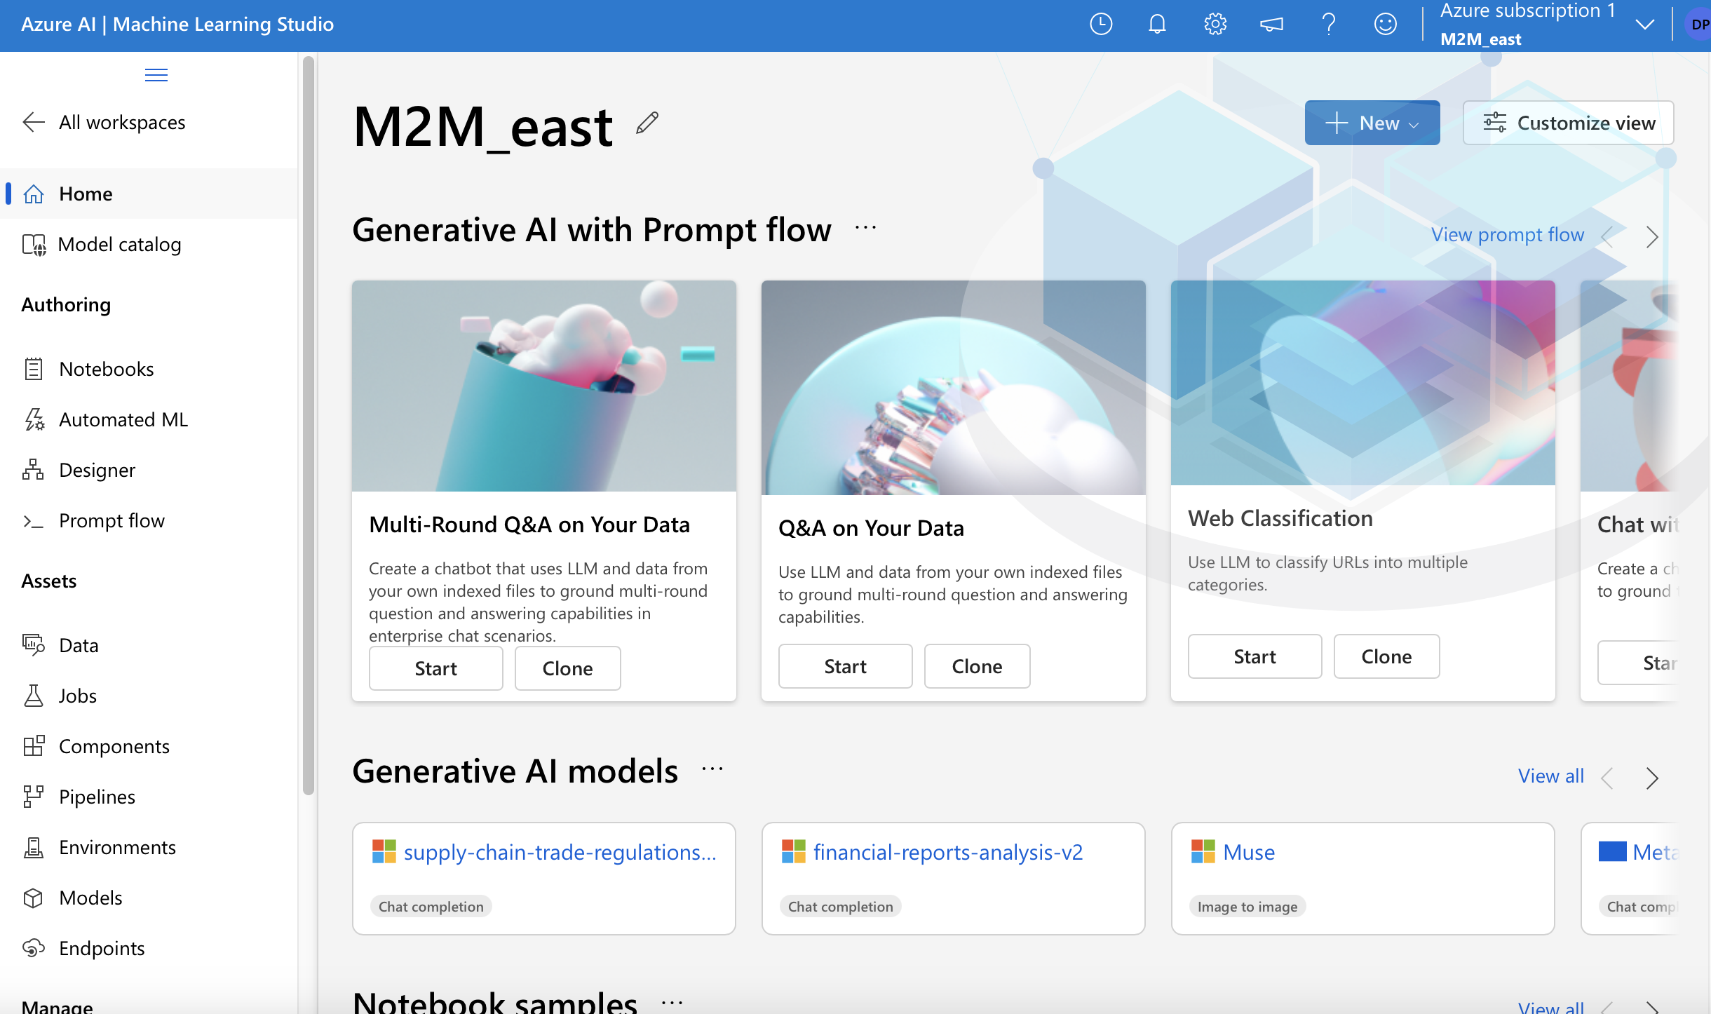
Creating Computing Instance

Slide 22
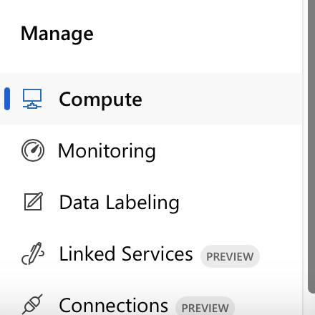

Click on Compute

Slide 23
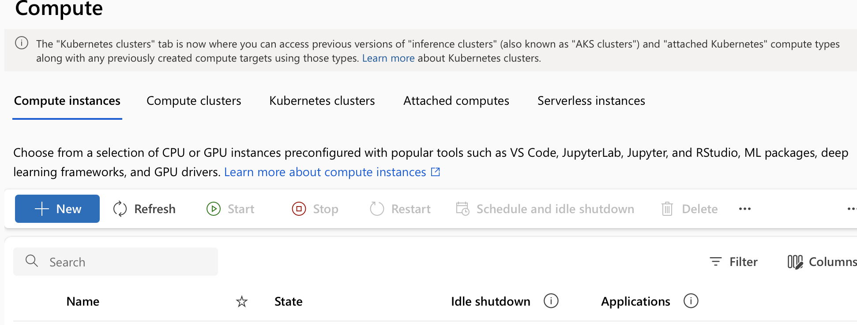
Click in Create New

Slide 24
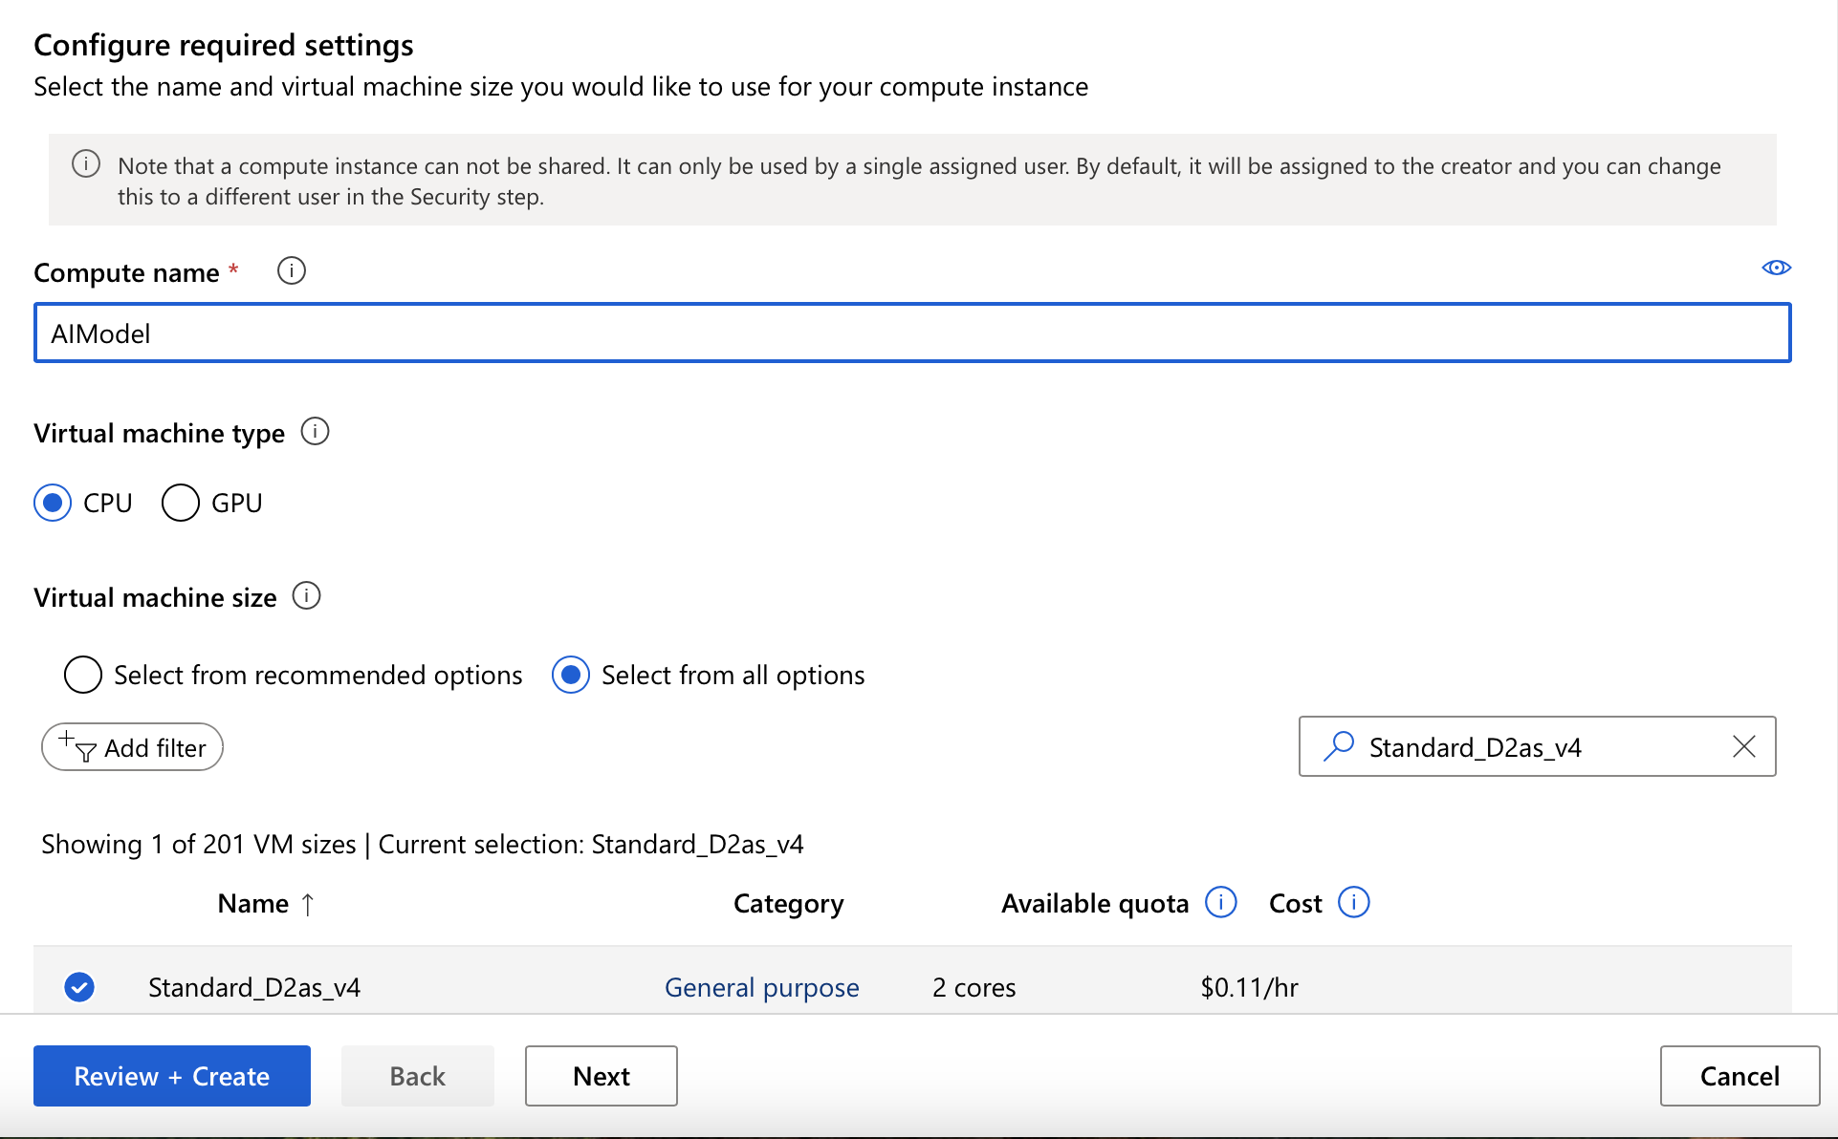
Give the required parameters and click on ‘Review + Create’

Slide 25
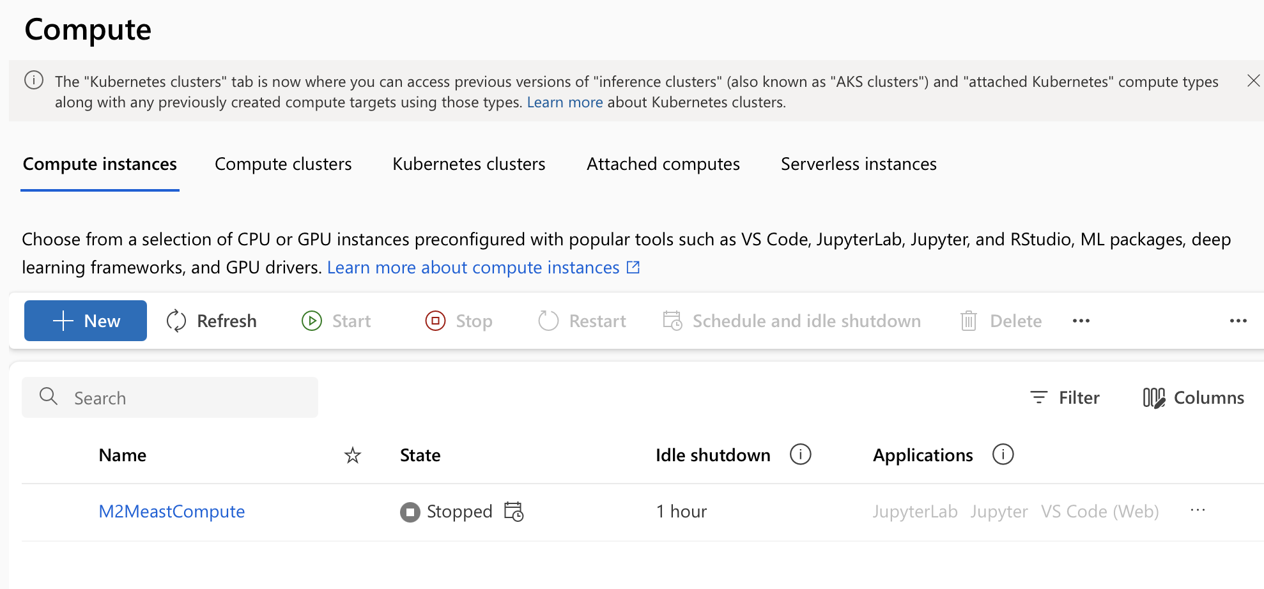
Compute instance is now created

